Slide 1
Introduction to Risk Assessment Basic Concepts
Unit 1B
Risk Analysis in Safety Engineering
Spring 2022

Slide 2
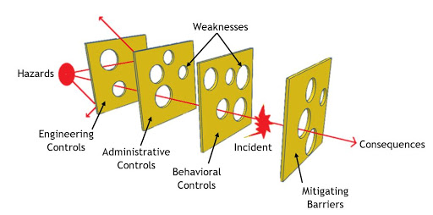
Reason’s Swiss Cheese Model of Incident Trajectory
Can you apply this model to reduce risk of getting sick in the pandemic?

Slide 3
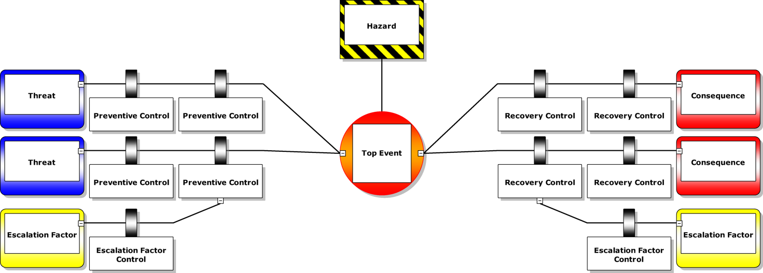
Barrier Model in Industry
Barrier models show conditions of barriers in a facility.
Data from various equipment and other sources are brought together to give an idea whether the barrier is functioning properly or not
Fault Tree
Event Tree

Slide 4
How to do Risk Assessment: The Basic Questions
What can go wrong?— Identify and characterize Hazards, develop Scenarios from initiation to outcome events due to the hazards under given or expected conditions
How likely? — Estimate Frequency or Probability distributions of scenario events including hazard barriers, and scenario outcome events under expected conditions
What are the Consequences or Outcomes? — Estimate magnitude or severity distributions of the scenario outcome events under expected condition ranges

Slide 5
Risk Assessment with Hazard Barriers
Identify Hazards: with a nature to cause losses (chemical, biological, thermal, mechanical, electrical, radiation).
Identify System Barriers. Each hazard is analyzed to select barriers for Prevention and for Mitigation of exposure to the hazard.
Identify challenges to barriers. Each barrier must be tested, monitored, and serviced to maintain its function, relative independence, & response to system demands.
Frequency or Probability. Scenarios that pose similar hazard exposure can be grouped to represent outcome occurrence frequency categories.
Consequence evaluation. Potential losses are estimated and modeled using knowledge and history of the hazard behavior under the expected condition ranges and amount of exposure.
What can go wrong?
How likely?
Outcomes?

Slide 6
Risk Assessment Map
System Data & Complementary Info
Hazards Characterization &
Scenario Development
Risk Re-Evaluation
Continue Updating
Probability/Freq. Analysis & Distribution
Consequence Analysis & Distribution
Risk Distribution
Risk Criteria
Risk Evaluation
Risk Reduction
System Monitoring & Measurement
Accepted Risk Level
Risk Governance
Risk Management
Risk Communication

Slide 7
General Risk Management Process
INITIATION
AVOID THE “ZONE OF UNCERTAINTY”
DEFINE SYSTEM & SCOPE
BROADEN
SYSTEM &
SCOPE
IDENTIFY HAZARDS &
ANALYZE RISKS
RISK CONTROL
(FACILITY SAFETY MANAGEMENT,
INCIDENT MANAGEMENT,
LAND USE PLANNING)
STAKEHOLDER
\PARTICIPATION
EVALUATE
RISKS
CANNOT DECIDE
NEED MORE INFORMATION
RISKS TOO HIGH
RISKS ACCEPTABLE
CONTINUOUSLY
CONTINUOUSLY
MONITOR & AUDIT
7

Slide 8
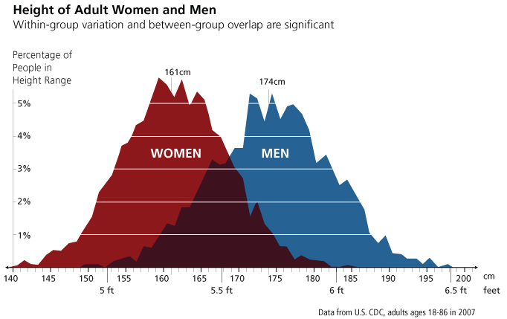
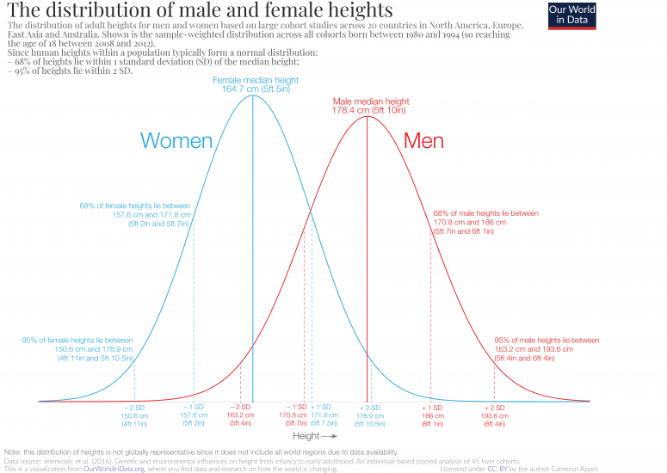
Why is risk a distribution and not a point value?
Because there is always some uncertainty in data measurement (aleatory uncertainty) or in the model (epistemic uncertainty)

Slide 9
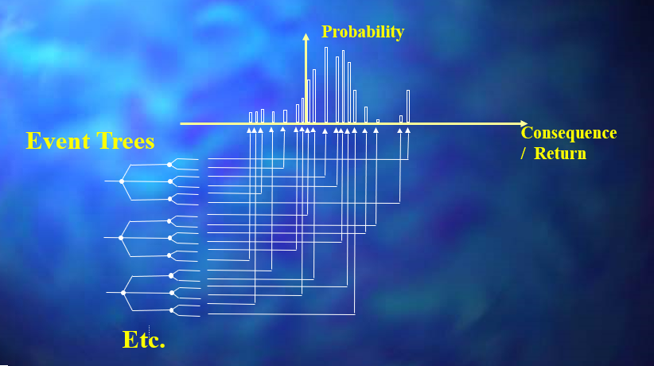
Risk/Return Relationship
“Maturing a Safety Management System into an Asset Integrity Case”, presented at the national conference of the American Institute of Chemical Engineers, Centre for Chemical Process Safety, Toronto, Ontario, Canada, October 2001

Slide 10
Risk Reduction and Management
Risk must first be measured or analyzed and categorized.
If risk is high, reduce risk within acceptable levels/ranges and then manage the reduced risk.
Ex: How do you manage the risk of combustion/fire?
Risk management is a continuous process.
Concentration < LFL (lower flammability limit)
Ignition energy < MIE (minimum ignition energy)
Oxidizer < MOC (minimum oxygen concentration)

Slide 11
Risk Management Strategies
HIGH RISKS
LOW RISKS
INTOLERABLE (DESIGN OUT)
RESIDUAL
Risk Acceptable to Company
RETAIN
TRANSFER
KNOWN
RISKS
MITIGATE
CONTROL
AVOID
PREVENT
INSURANCE
WHAT ABOUT THE UNKNOWN RISKS OR THE “LATENT DESIGN DEFECTS” ?
11

Slide 12
Risk Communication & Governance
Risk communication refers to the activity of transferring, exchanging, deliberating, and sharing data, information, uncertainties, and knowledge about risk, results of risk assessment, decisions, and risk management among the decision makers, analysts, plant personnel, and stakeholders including the public.
Share information about:
Nature of the Risk → characteristics and level of hazard, severity, and dynamic behavior of risk
Nature of the Benefits → benefits vs risk, including direct and indirect benefits, are clarified in qualitative and quantitative terms
Credibility: Characterization of uncertainties → in methods, models, and expertise used to assess risk
Confidence/trust: Risk management options → to arrive at a strategy, policy, or regulation & actions to Manage Residual Risk & Uncertainties throughout system life cycle
Risk governance refers to the rules, policies or mechanisms by which decisions about risk are taken and implemented

Slide 13
System RA Steps
Identify and characterize hazards
Develop scenarios of upset events, conditions
Assess risk and represent in risk profiles
Categorize, prioritize contributions to the overall risk
Reduce risk, Manage risk within acceptable ranges
Communicate risk with personnel and stakeholders
Train/retrain personnel, educate/update stakeholders
Monitor, measure system & organization, find trends
Continually update system data and parameters
Update behavior predictions of components and system

Slide 14
Risk Assessment, Management, Communication
Risk
Assessment
Risk & Uncertainty
Management
Decision Making Under Uncertainty
Evaluation,
minimization,
and control of
risk within
acceptable limits
Estimations of
probabilities and
consequences
Risk Communication& Governance Framework
Exchange, share, discuss, deliberate the risk
and consequence analysis & major decisions with Stakeholders
(adapted from Modarres, RAE)

Slide 15
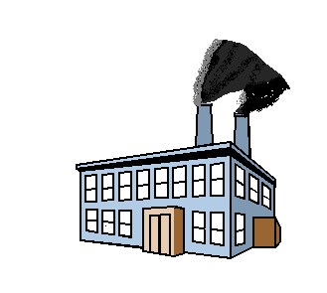
What is loss?
Loss
$
PROFITS
MONTH
A net reduction in value or appeal
15

Slide 16
Loss Sequence Diagram
Loss: an insurance term used to quantify damage.
HSE&S in some companies was called Total Loss management Group
LOSS
RISK
FAILURE
HAZARD
16

Slide 17
Why Assess Risk?
Determine if action needs to be taken.
Determine what action needs to be taken.
Determine when action needs to be taken and in what order.
Determine if actions taken are effective in reducing risk.
17

Slide 18
Risk vs. Uncertainty
Risk is a measure of
Potential loss.
It is quantifiable.
Uncertainty lacks definition.
It is somewhat random.
It is flying blind!
Air France 442 - June 1, 2009
A330 flight from Rio to Paris
Why did it crash?
18

Slide 19
The Perception of Risk
Is the perception of risk important?
Example: Mud Burner systems on the HIBERNIA platform.
19

Slide 20
Hibernia Mud Burner System
Purpose:
Dispose of the residual drilling fluid material (oil contaminated mud, cuttings wash fluid, oil from platform drains) by combustion.
Burner Design:
Burner heads are mounted on the end of a boom 18.3 m from the edge of the platform
System consists of two burners booms located at the NW and NE corners of process module.
20

Slide 21
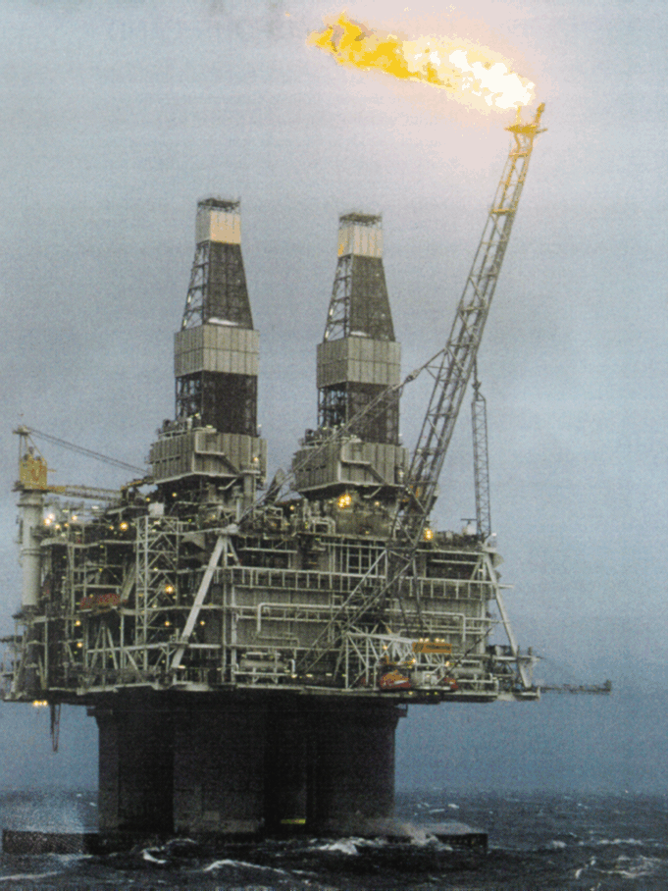
Hibernia
21

Slide 22
Operational Concern for Hibernia Mud Burners
Operators on the platform perceived the mud burners as an ignition source for accidental releases of gas during upset conditions and did not want the units to be operated.
Question: Does the operation of the mud burners pose an unacceptable risk to the Hibernia platform?
22

Slide 23
Resolution of Concern
Went offshore to discuss and resolve the issue
Conduct a planned brainstorming session on the platform to identify all issues / concerns.
Review operating parameters and protocols.
Determine factors and feasibility of on-shore disposal
Identify plausible gas release scenarios for modelling
Conduct detailed guide-word HAZOP of Mud burner system. (HAZard & OPerabilbity study)
Perform gas release scenario modelling to determine ignition potential (LFL/5).
Result: Mud burners were not used.
23

Slide 24
Questions about Risk Assessment
Question 1: Given the practice of QRA, why are numerous industrial upsets still occurring?
Practice must be updated!
Question 2: To what degree can “low probability, high consequence” events be predicted, e.g., the 2008 world-wide financial crisis, 2005 BP Texas City, 2010 Deepwater Horizon?
We will find that may incident indicators or precursor events can be monitored for probabilistic forecast of future system behavior

Slide 25
Questions about Risk Assessment
Question 3: Is risk assessment costly? How do you justify the use of risk assessment to managers, company stakeholders, government auditors?
An air traffic control center works to improve safety but must ensure that proposed improvements are cost effective and do not reduce efficiency. Competing proposals for safety improvement include new radar, new collision avoidance detection devices, and improved staff training and leadership.

Slide 26
Challenges of the 21st Century
During the 21st century, meeting the world’s increasing demand for food, water, and energy will be a daunting challenge and opportunity that will engage interactions of world leaders together with engineers and scientists.^
Defining the constraints associated with the food, water, energy relationships, and optimizing the complex functions of interdependent variables will require not only the discovery of new chemistry and engineering development but also employment of rigorous Risk Analysis and optimal Decision Making Under Uncertainty by Citizen Engineers’ aggregation of all relevant information.^
^ Adapted from Matthew Platz, National Science Foundation, Division of Chemistry Newsletter, December 2012, Issue 19, p. 2

Slide 27
Cardinal Rules of a Systems Approach to Decision Making
Several Cardinal rules should be acknowledged to perform Risk Assessment of a Sociotechnical System (STS).

Slide 28
Cardinal Rule 1: Technical and Organizational
1. Define the socio-technical system (STS) and its hierarchy of levels to include the technical engineering system and its organization.
Acknowledge and understand that technical issues (e.g. equipment and operation) are influenced by non-technical issues such as management, organization and higher levels of the system
Sociotechnical systems (STS) are complex interaction of human and technology
Technical, operational, human and organizational factors

Slide 29
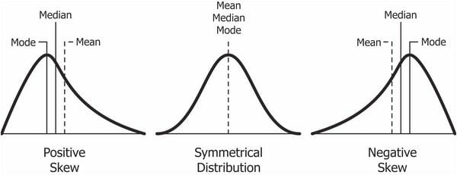
Cardinal Rule 2: Uncertainty
2. All Information about a STS is Uncertain to a degree.
Decisions involve uncertain information and involve uncertain future events. Therefore, each decision itself contributes to the overall Risk, lowering or increasing the risk
Avoid Certainty Delusion; avoid point value orphans by estimating uncertainties of sensitive variables.
Distribution tail behavior can be critical to decisions.

Slide 30
Engineering is Based on Science
One of the greatest achievements of 20th century science was to demonstrate that uncertainty is an inherent characteristic of nature or of reality.
As an engineer, we must expect variability in engineering practice due to variability of conditions and properties, or simply because of influence of things we are not aware of.
Variability in conditions and properties results in ranges or distributions in frequency/probability of outcome occurrence and in ranges or distributions in outcome consequences.
All information about a STS is uncertain to a degree.

Slide 31
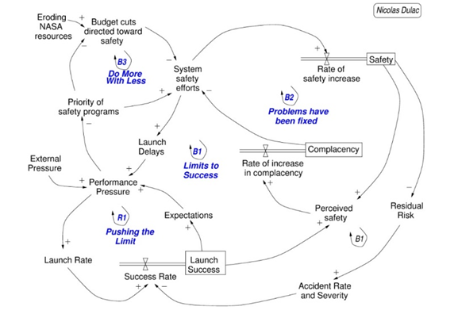
Cardinal Rule 3: Interdependency
3. Many STS components are significantly Inter-dependent
Challenger Space Shuttle 1986 launch under poor conditions:
Lack of near miss learning, complacency, and pressure to launch led to catastrophe
(Pasman, Nancy Leveson, 2015)

Slide 32
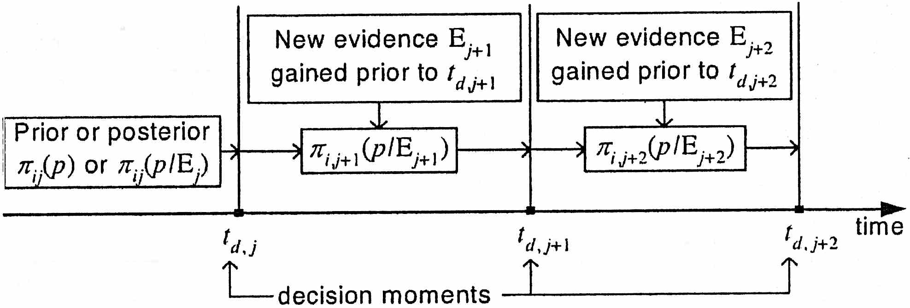
Cardinal Rule 4: Time-dependency
4. All components of a STS are Time dependent, so dynamic decision models are needed for modeling and management.
Equipment degrades
People leave jobs
Government changes etc.
Old information
Update
Update
Be agile to incorporate new relevant information
(Zavadskas, 2008)

Slide 33
Cardinal Rule 5: Conditional dependency
5. All probability values, model parameters, and other information are dependent on Conditions, so condition ranges must be specified or estimated based on other information concerning the application.
Ex. of conditional probability, B = observed wind speed:
For A = wave height ≤ 6’, P(A|B) = 0.25, if B = normal wind
If B = wind speed > normal; P(A|B) < 0.25
If B = wind speed < normal; P(A|B) > 0.25
P(A given B) where P designates probability
Broad ranges in conditions lead to broad ranges in outcomes and broad ranges in probabilities or frequencies of outcomes, and consequently to broad Risk Distributions.

Slide 34
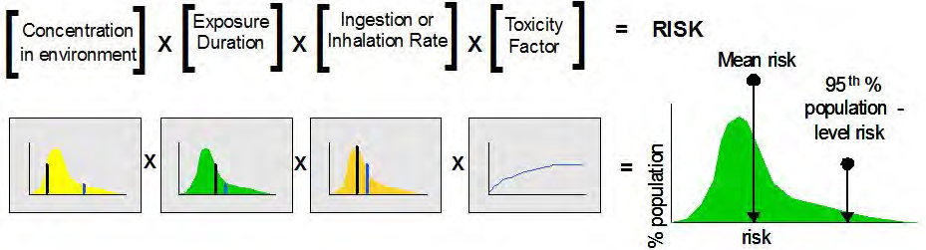
Cardinal Rule 6: Consider entire data range
6. All data and other relevant information are analyzed to model and manage a STS with optimal decision support. No relevant information is arbitrarily discarded.
(Toxic Exposure)
Each factor is modeled in its own distribution based on the data for that factor. Note that 3 of the factor distributions are skewed with tails that weight or bias the mean values (shown by the shorter vertical lines) to values higher than the median, which is shown by the first black vertical line of each factor .
The Risk distribution of toxic exposure is shown in the final distribution with ‘% Population exposed’ along Y and the ‘Risk level’ along X-axis. The upper confidence limit at the 0.95 or 95% level shows that 5% of the population is exposed to severely high risk
(EPA, 2014)

Slide 35
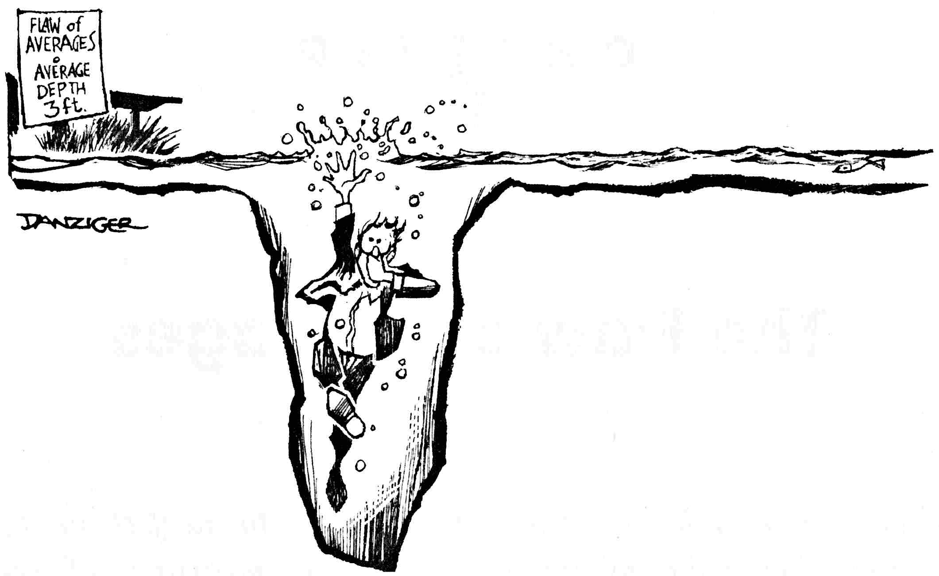
The Flaw of Averages
Average Depth
3 feet
Point value decision maker drowns due to failure to account for uncertainty in the depth of water.
Our culture encodes a strong bias either to neglect or ignore variation. We tend to focus instead on measures of central tendency, such as averages, and as a result we make costly mistakes.
Flaw of Averages: Plans based on average assumptions are wrong on average.^
^Savage, FOA
(Gould, 1996)

Slide 36
Grand Forks, North Dakota Red River 1997 Flood
In Spring 1997, the US Weather Service issued a forecast that the Red River was expected to crest at roughly 50 feet, which the dikes were designed to withstand.
But people accepted 50’as a certain limit without uncertainty. The average of a crest of 45‘ (damage of $0) and a crest of 55’(damage of $2 billion) is 50’ (damage of $0) but the average damage over this range is 0.5 (0 + $2 billion) = $1 billion.
The resulting flood crested at 54’ and forced an evacuation of 50,000 people from their homes.
If the potential range of the crest level had been communicated and discussed, actions could have been motivated and taken to mitigate the potential loss consequences.

Slide 37
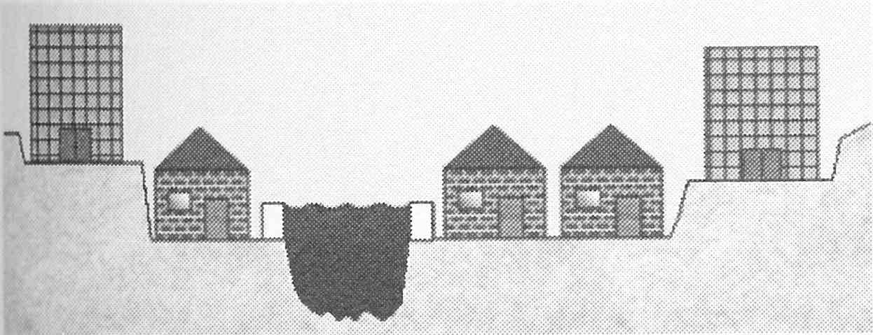
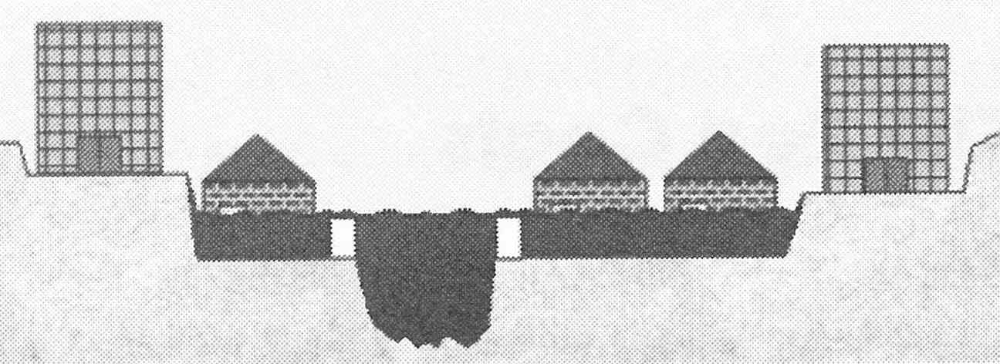
Red River Flood Levels Near Average
dikes
Level below average: no damage
Red River
Level above average: catastrophic damages
flooding
flooding
Savage, FOA

Slide 38
Cardinal Rules of a Systems Approach to Decision Making
1. Define the socio-technical system (STS) and its hierarchy of levels to include the technical engineering system and its organization.
2. All Information about a STS is Uncertain to a degree. Avoid Certainty Delusion; Avoid point value orphans by estimating uncertainties of sensitive variables.
3. Many STS components are significantly Inter-dependent, such as dysfunctional component interactions and feedback loops.
4. All components of a STS are Time dependent, so dynamic decision models are needed for modeling and management.
5. All probability values, model parameters, and other information are dependent on Conditions, so condition ranges must be specified or estimated based on other information concerning the application.
6. All data and other relevant information are analyzed to model and manage a STS with optimal decision support.

Slide 39
Risk Tolerance / Acceptability
How does a company establish what risk level it will tolerate?
What criteria need to be established for ?
Impact / consequence categories
Probability ranges
What tool is most commonly used
Qualitative
Quantitative

Slide 40
Risk Matrix
Consequence categories
Property damage
Human injury
On site
Offsite - public
Environmental impact
Loss of revenue (business interruption)
Probability categories
Qualitative: Infrequent to frequent
Quantitative: 10⁻⁶ to 10⁻²
Semi-quantitative: Based on the number of layers of protection in place for each event scenario

